Slide 1
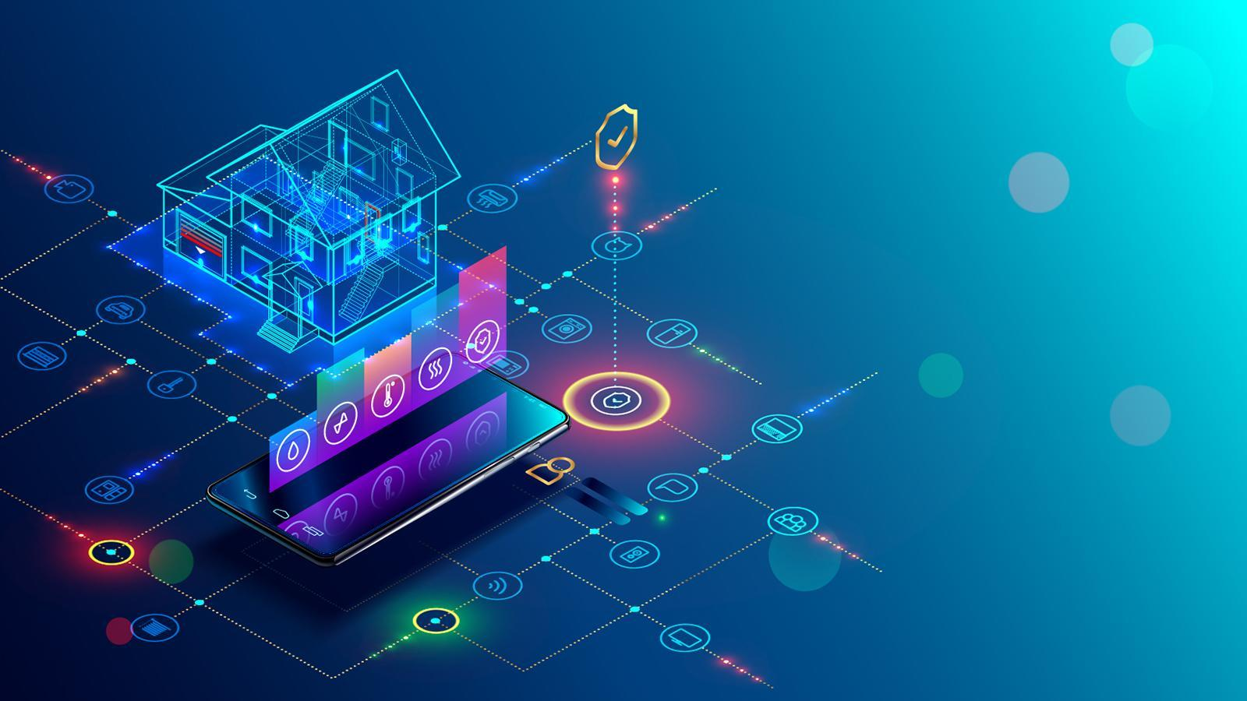
SMART SECURITY ALARM SYSTEM using IoT
By Hamad Abdelrahim, Nikhil Aditya Chaganti, and Alan Palayil

Slide 2

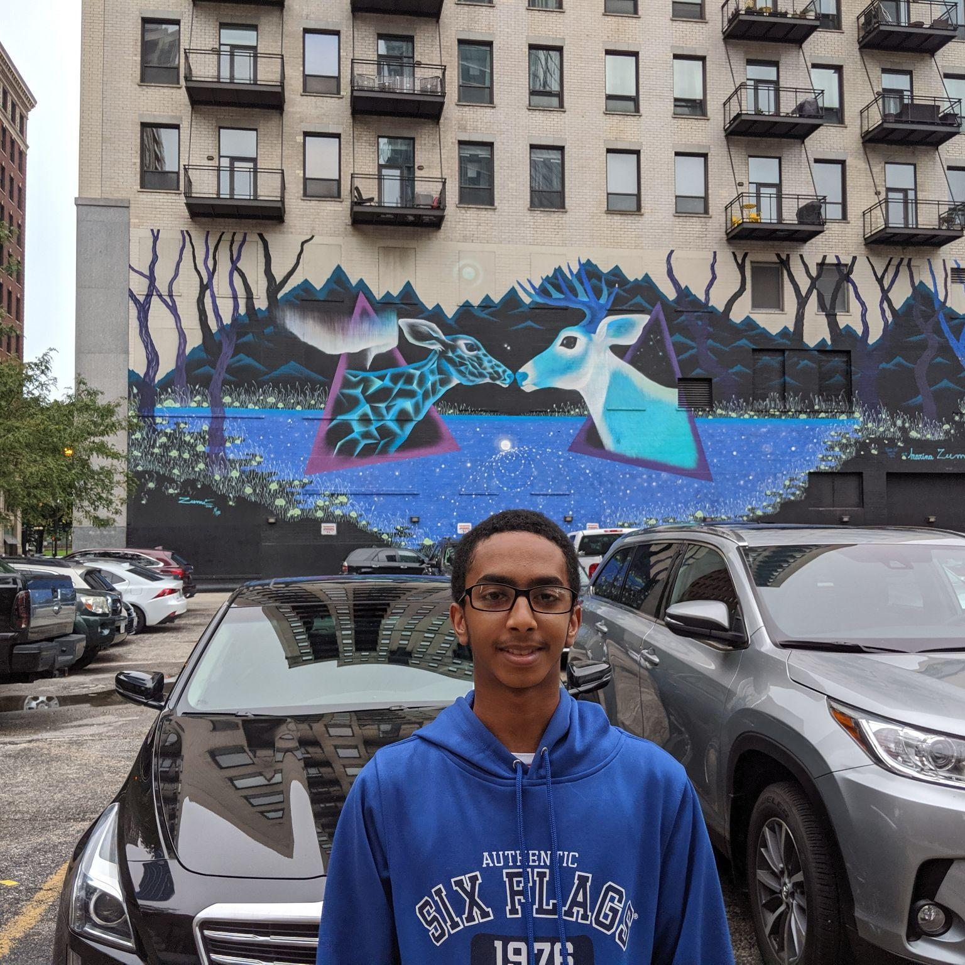
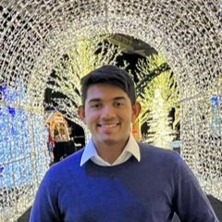
NIKHIL ADITYA CHAGANTI
I am a 4th-year in B.Sc. in Computer and Cybersecurity Engineering. I have experience in recommending and implementing security standards and best practices in various projects.
THE TEAM
HAMAD ADBELRAHIM
ALAN PALAYIL
I am a 4th-year in B.Sc in Computer Engineering. I have worked on facilitating first person view on drones for a project and worked on coding projects using experience gained from courses.
A Computer and Cybersecurity Engineering major who is focused on the software integration and design architecture for the Home Security System project. In the past, I have integrated IOT hubs and built a couple of smart home proposals. The smart home included cloud connectivity and security monitoring.

Slide 3
TABLE OF CONTENTS
01
02
03
SUMMARY
COMPONENTS & SOFTWARE
MILESTONES AND DISTRIBUTION
04
05
FUTURE WORKS
CONCLUSION AND REFERENCES
Overview of the project
The list of components used in the product
Timeline and milestones, and work distribution
List of possible future modifications for the project
List of references used in the project
Notes:
These are the contents we are going to glance over in this presentation.

Slide 4
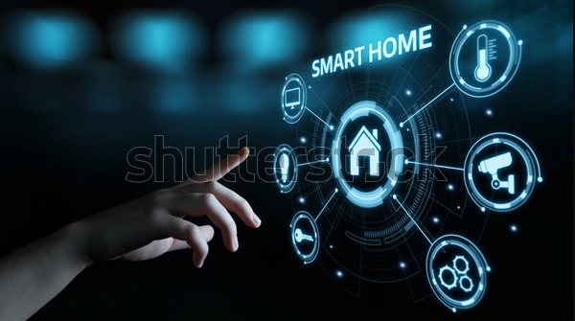
01
DESIGN AND SUMMARY

Slide 5
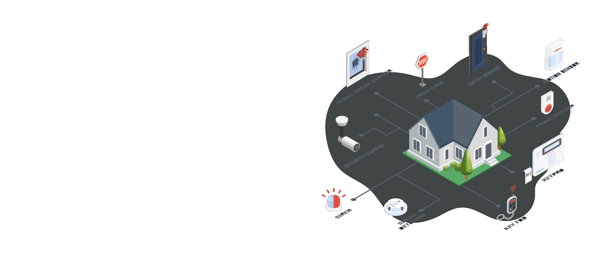
PROBLEM STATEMENT
Smart Home Security Systems are a key system being developed in the IoT field often limited to the coverage, false alarm, and power usage.
We are developing a smart alarm system which can detect the presence of users and activate camera with facial recognition using motion to decrease power consumption and false alarm along with monitoring the household.
The system comprises of various sensor to monitor and detect abnormalities and report them to the users via mobile-app.

Slide 6
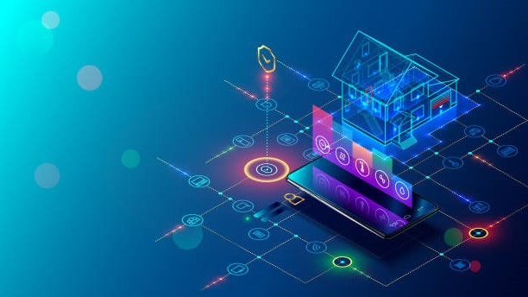
PROJECT OVERVIEW
We aim to develop an anti-intrusion smart home security system which can detect the presence of users and through a camera, run a facial recognition algorithm to grant access only to authorized individuals, and alert users to failed scans or forced entry via a companion app.
The system comprises of a Raspberry Pi, ESP8266 Node, camera, keypad, magnetic reed switch, and an ultrasonic sensor. These components will work in tandem to provide intrusion security and home safety.

Slide 7
KEY FEATURES OF OUR PROJECT
Motion Detection
Ease
of Usage
Facial Recognition
Presence Detection
Modular Design
An individual (user/intruder) can be detected using our motion detection system. It uses an ultrasonic sensor to detect individuals within a certain radius.
Users have easy control of the system via the companion app that provides environmental information remotely.
Through OpenCV, users can gain entry using a database of saved facial profiles and grant access to others, all via a camera
Home Assistant allows our system to detect the presence of a user within a certain area and it allows for a range of automation features.
The entry-point system is designed with modularity in mind, allowing application in a variety of entry-points such as windows, with little modification.

Slide 8
DESIGN OVERVIEW
Motion is Detected
Countdown Begins
Intruder Alert!
Contact at the Door
Scanning the Face
The alarm stays off until motion is detected by an ultrasonic sensor within a certain range of the door, upon which the system is armed.
Once the countdown starts, individuals have a user-determined amount of time to pass the facial scan or enter the PIN.
If the facial recognition scan fails or the wrong PIN is inputted, the alarm will ring, and a notification will be sent to the user via the companion app, along with a picture of the intruder’s face.
Following the normal lock-and-key entry, opening the door triggers a magnetic contact sensor, which initiates a silent alarm countdown.
Opening the door triggers
the camera and the PIN keypad. Passing the scan, or inputting the PIN as backup will disarm the alarm.

Slide 9
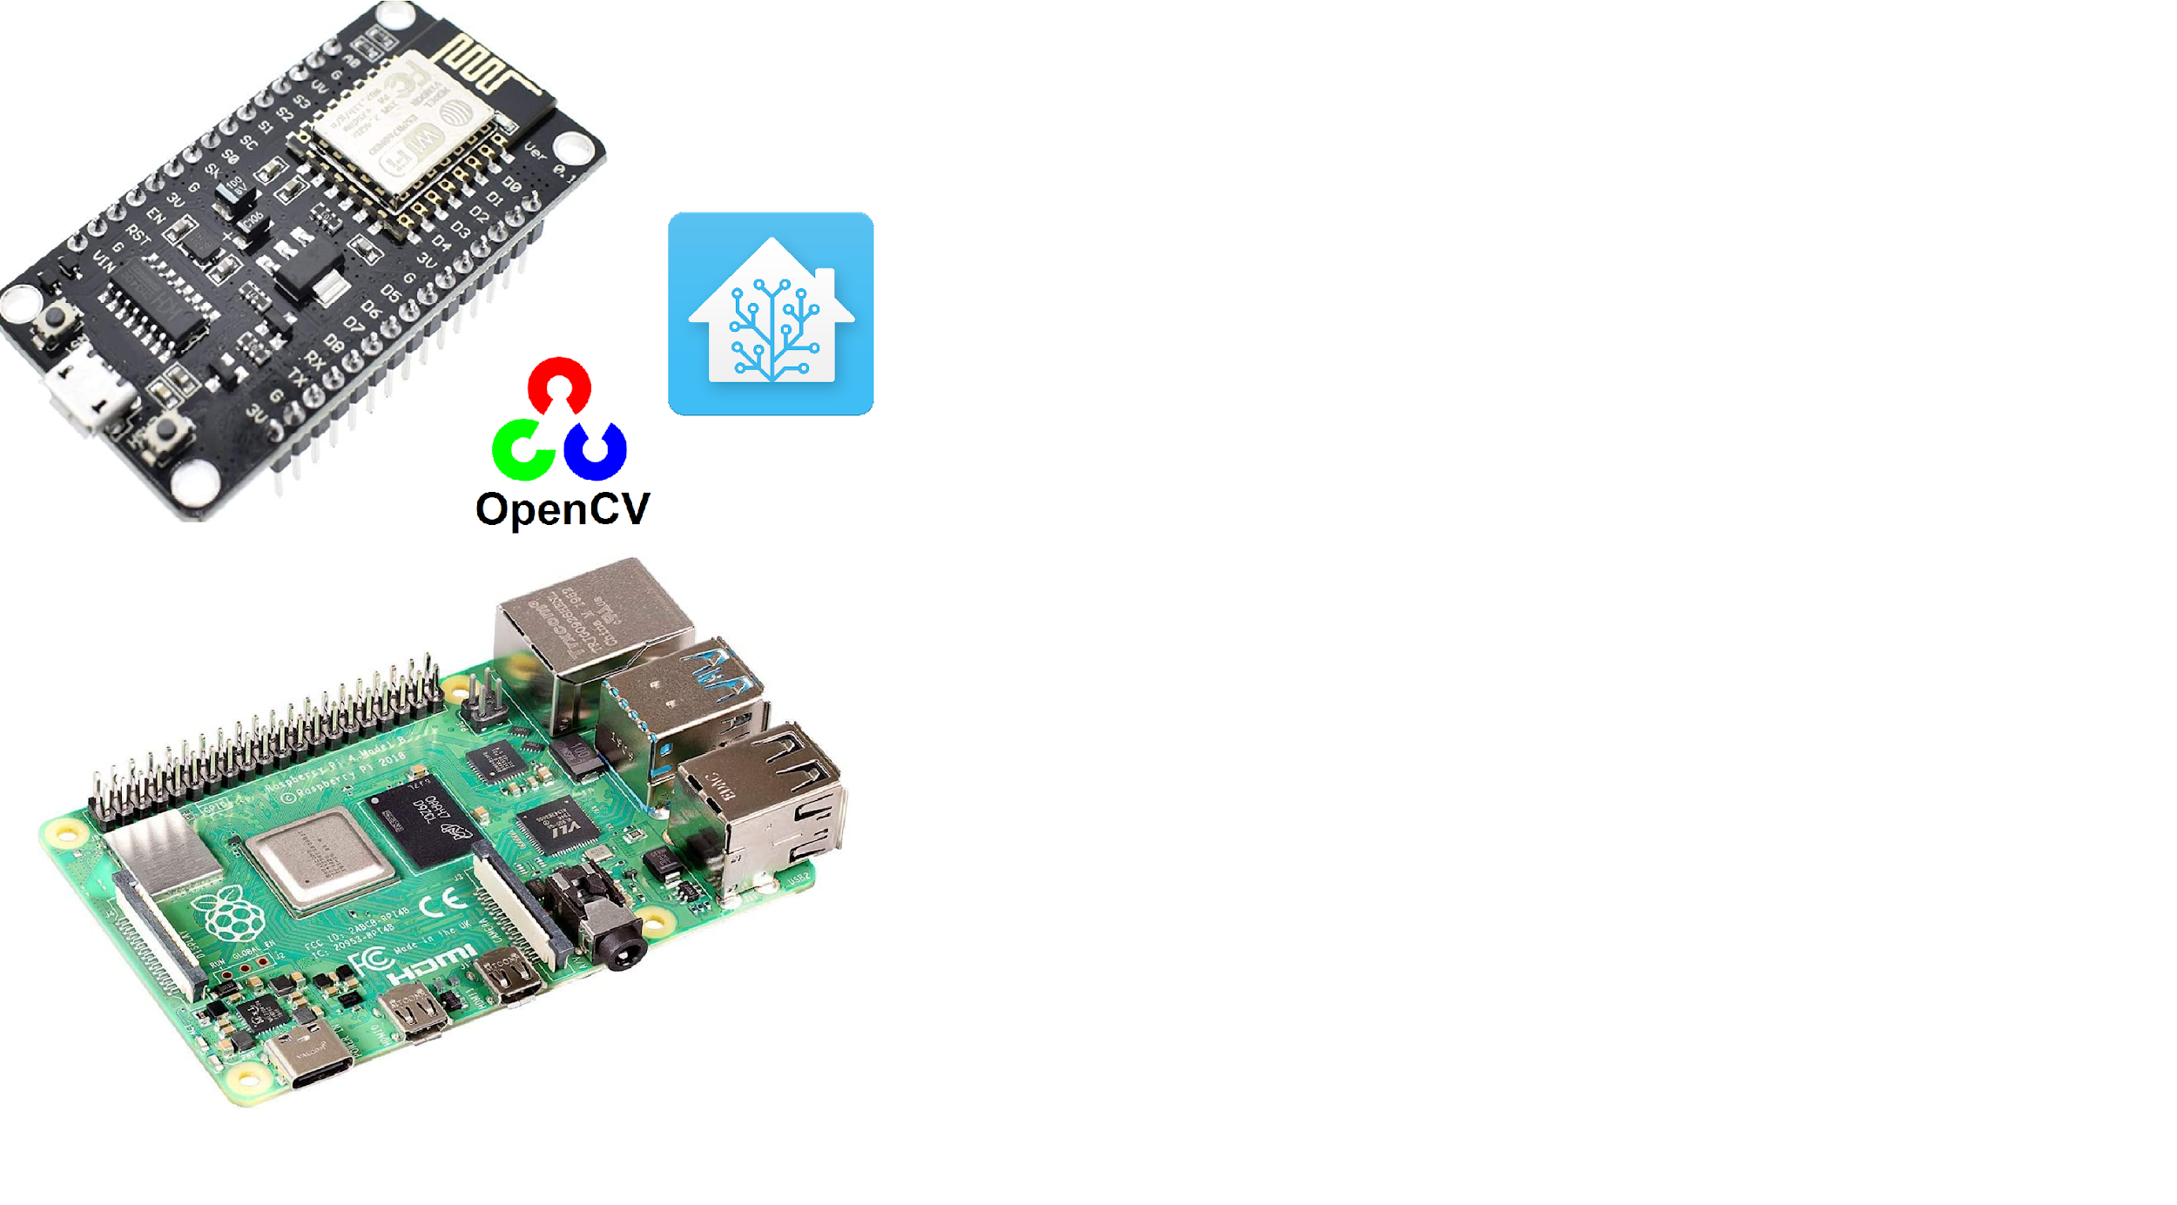
02
COMPONENTS & SOFTWARE

Slide 10

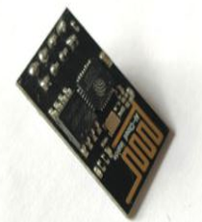
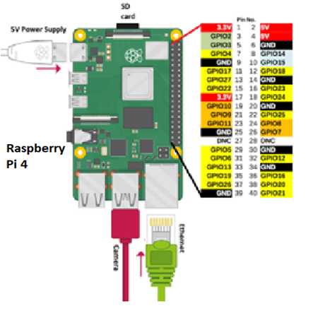
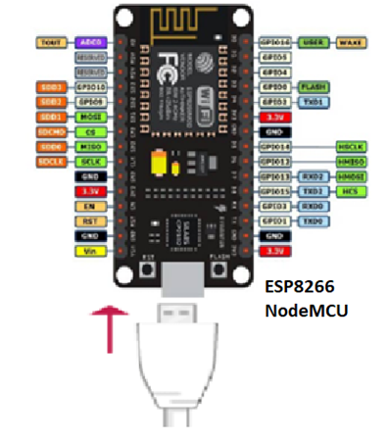
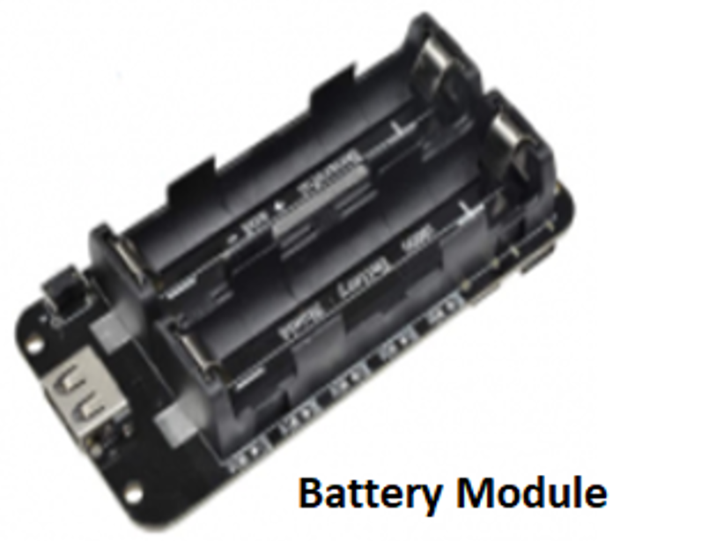
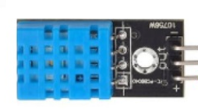
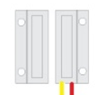
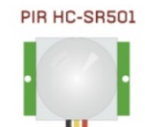
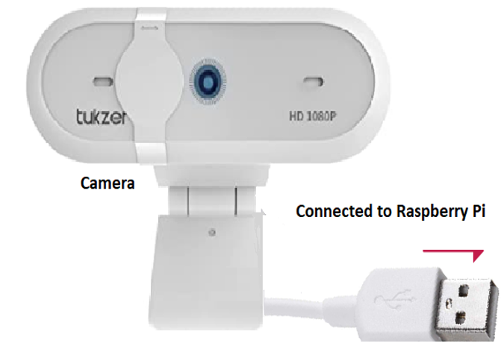
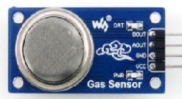
HARDWARE COMPONENTS
Raspberry Pi
The Pi was booted with the Home Assistant OS which is an open-source platform to develop various IoT home related projects. The local server in our project collects and stores the data from the microcontroller in the SD card, it later processes the data and uploads it on the Home Assistant Platform.
ESP8266 NodeMCU
The microcontroller which is being used for this project and acts as a hub to collect and send data to the sensors and nodes. It is a development board based on Lua firmware. It was selected for its low power consumption and built-in WiFi SoC chip.
USB Camera
The camera will be used to run facial recognition to disarm the system and can be used to monitor the entrance using motion sensor.
PIR Motion Sensor
The sensor detects the motion of a human body using Passive Infrared sensor. It is used in this project to activate the camera on motion and capture images/videos.
Magnetic Reed Switch
When the magnet is closed by, the circuit is closed or open if the magnet is far from the sensor. The trigger shows the status of ON/OFF which can be viewed in the Home Assistant platform.

Slide 11
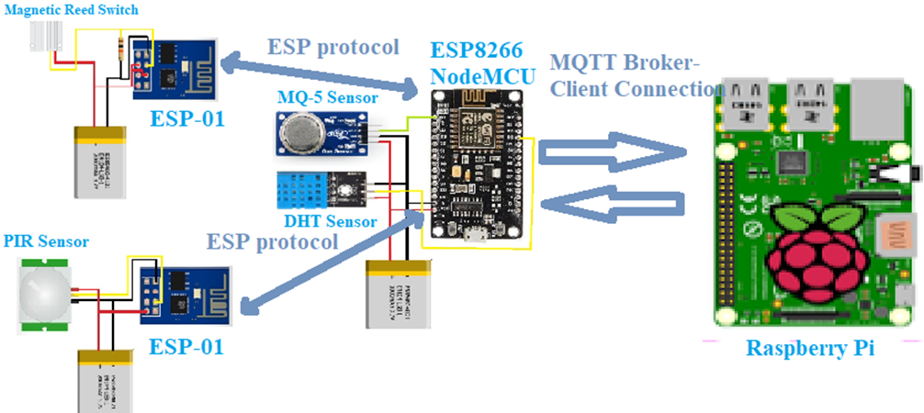
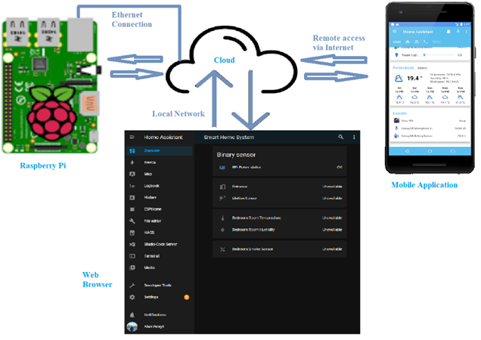
Communication
The system is divided into 2 groups:
The Pi group comprises of the Raspberry Pi, camera, and keypad. The keypad is connected to the Pi via the GPIO pins, and the camera is connected to the USB 3.0 port of the Raspberry Pi. The Pi itself is connected to the internet via the ethernet which provides a physical internet connection. The Pi acts as a local server and connects to the Home Assistant platform via the internet.
The NodeMCU group consists of the ESP8266 NodeMCU along with various sensors. The NodeMCU acts as the microcontroller hub through which the data from the sensors is transmitted to the local server (Raspberry Pi). The WiFi modules communicate using the ESP protocol and transmits the data to the local server through the MQTT protocol via local network.

Slide 12
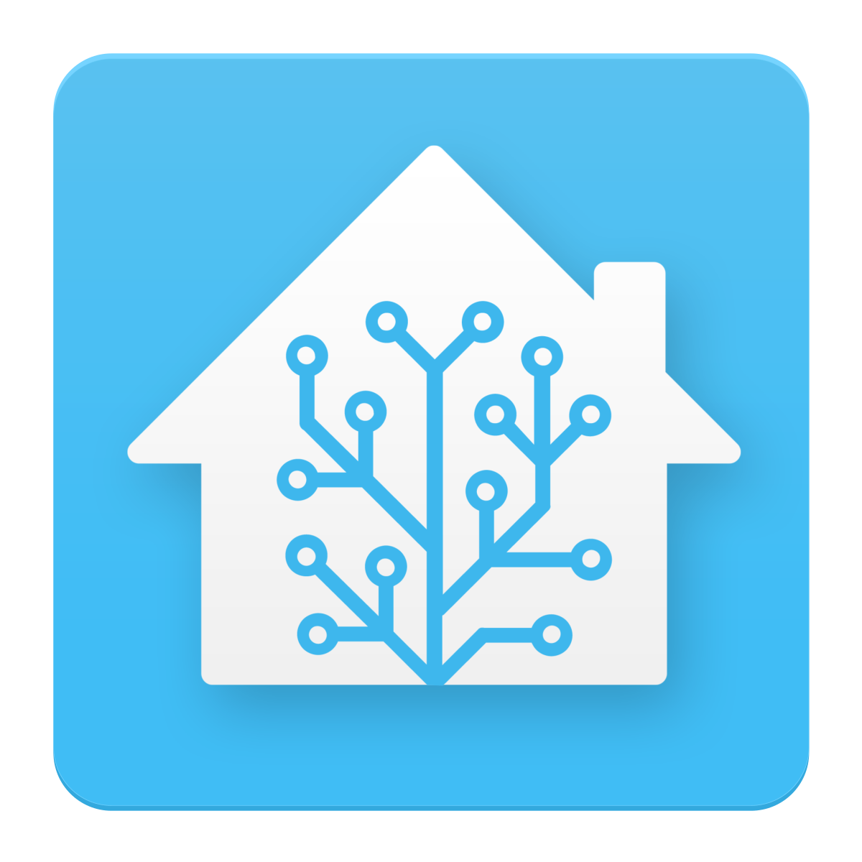

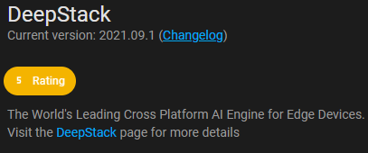
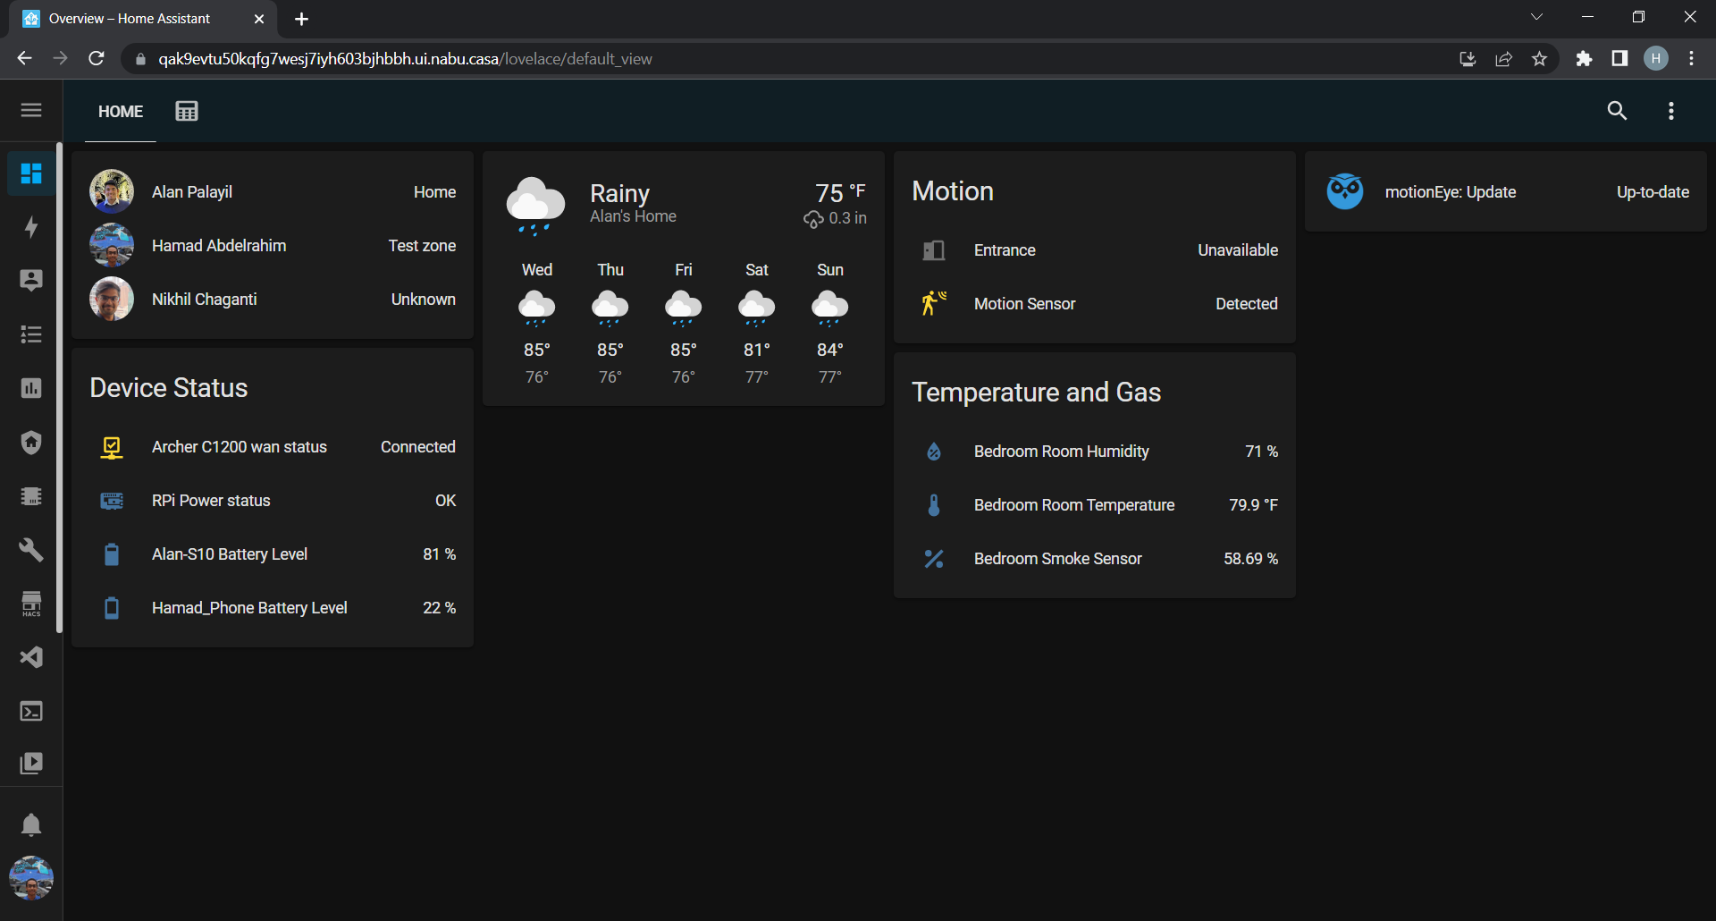
SOFTWARE COMPONENTS
Home Assistant
It is an open source home automation that puts local control and privacy first.
It is used as the main platform to connect the sensors and actuators to the cloud.
Using in-platform services like ESPHome and MQTT broker
Home Assistant keeps your data local, no need for a cloud.
Deepstack
Using Deepstack integration on Home Assistant, a camera can detect motion and run facial recognition scans.
Deepstack is manually taught new faces to improve recognition accuracy.
IFTTT
Used in the back-end to implement automations and Google Services.
It communicates using the MQTT protocol.

Slide 13

Initializing the Sensors
Our system makes use of four different sensors:
Door sensor (Reed Switch)
Motion sensor
Temperature sensor
Gas sensor
All these sensors are connected to Home Assistant using the NodeMCU or ESP-01 module and ESPHome integration:
The program supports OTA (Over the Air) installations.
This creates versatility as updates to the sensors can be wirelessly

Slide 14
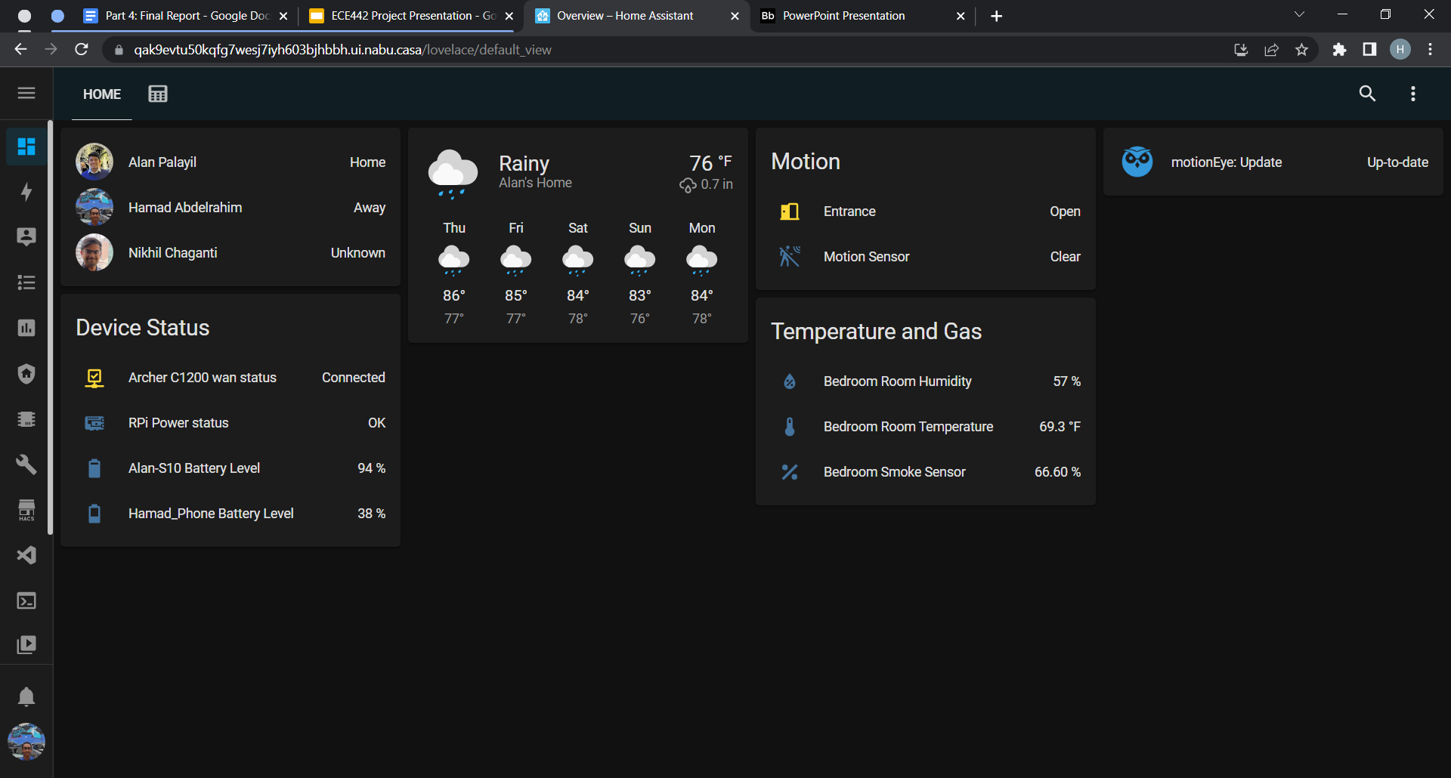
Dashboard Overview: Home
Home
The dashboard is divided into two sections, Home and Alarm System.
Under Home the user has access to the following information:
Current weather.
Status of sensors.
Bed room temperature, humidity, and gas concentration.
User’s presence at home.
User’s phone status.

Slide 15
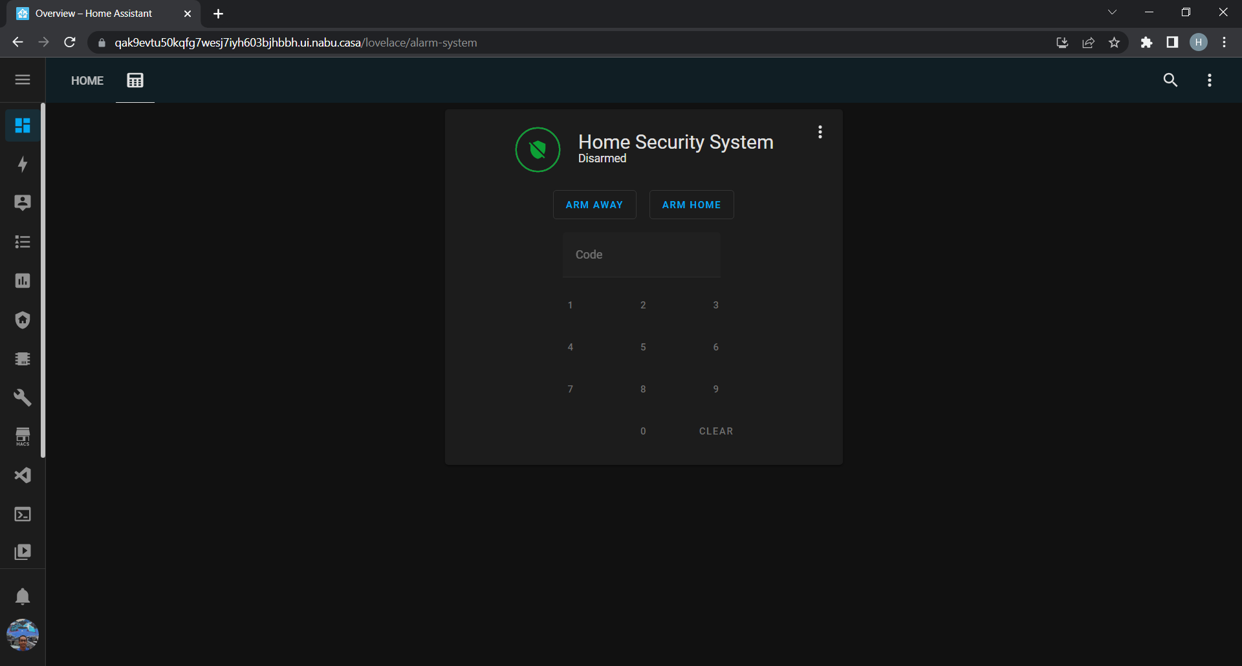
Dashboard Overview: Alarm System
The alarm system section provides the user with a keypad to enter a code to disarm the system and allows the user to arm the system under two modes:
Home
Away
Under Home the system activates external sensors such as the door sensor and external motion detection sensors.
Under Away it activates the same sensors as Home but also activates any indoor sensors.

Slide 16
Presence System
Network Based Detection
Uses the user’s home network to detect their presence.
Home Assistant will periodically sends a single data packet (ping) to the user’s phone IP address.
If it replies then the user’s state will change to “home”.
Else it will change to “not_home”

Slide 17
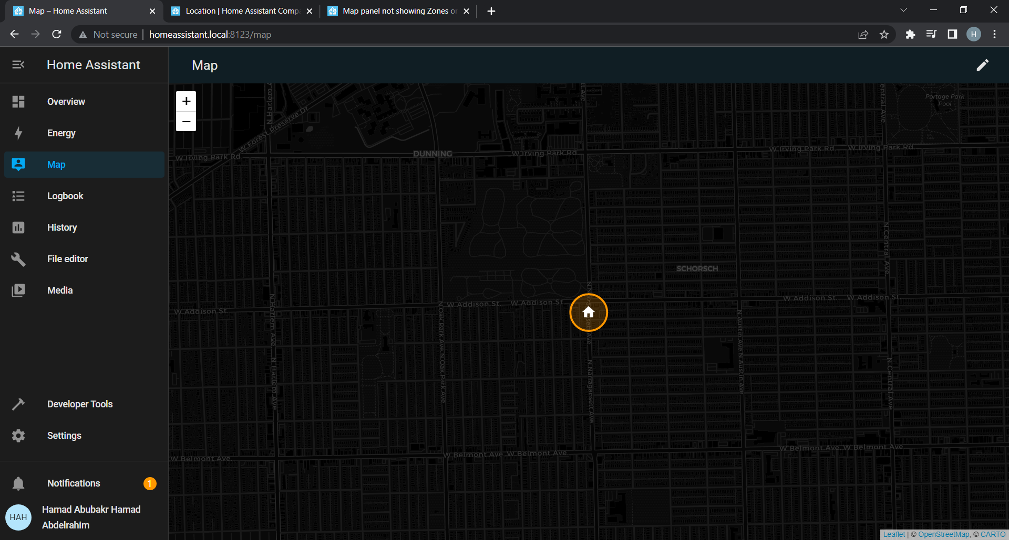
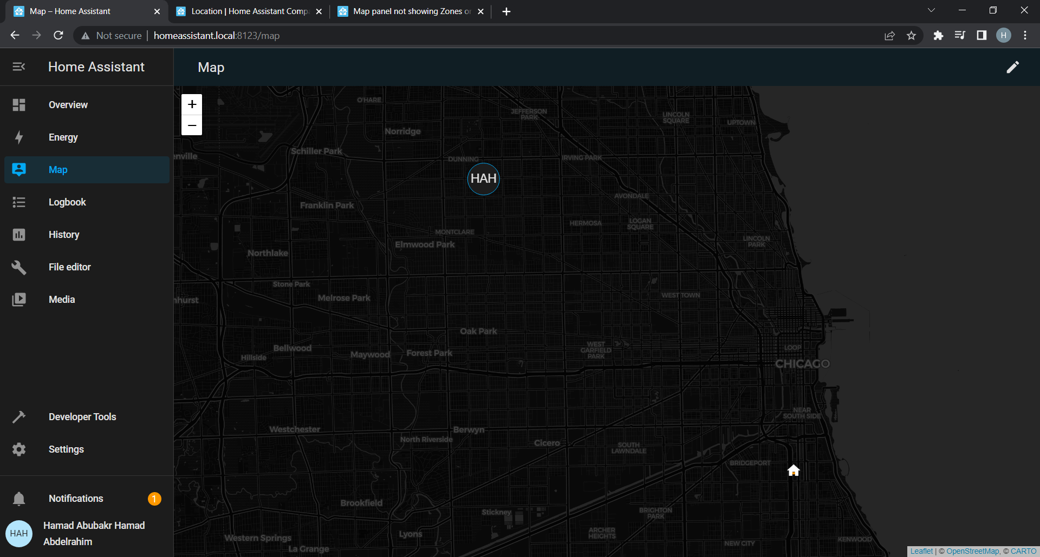
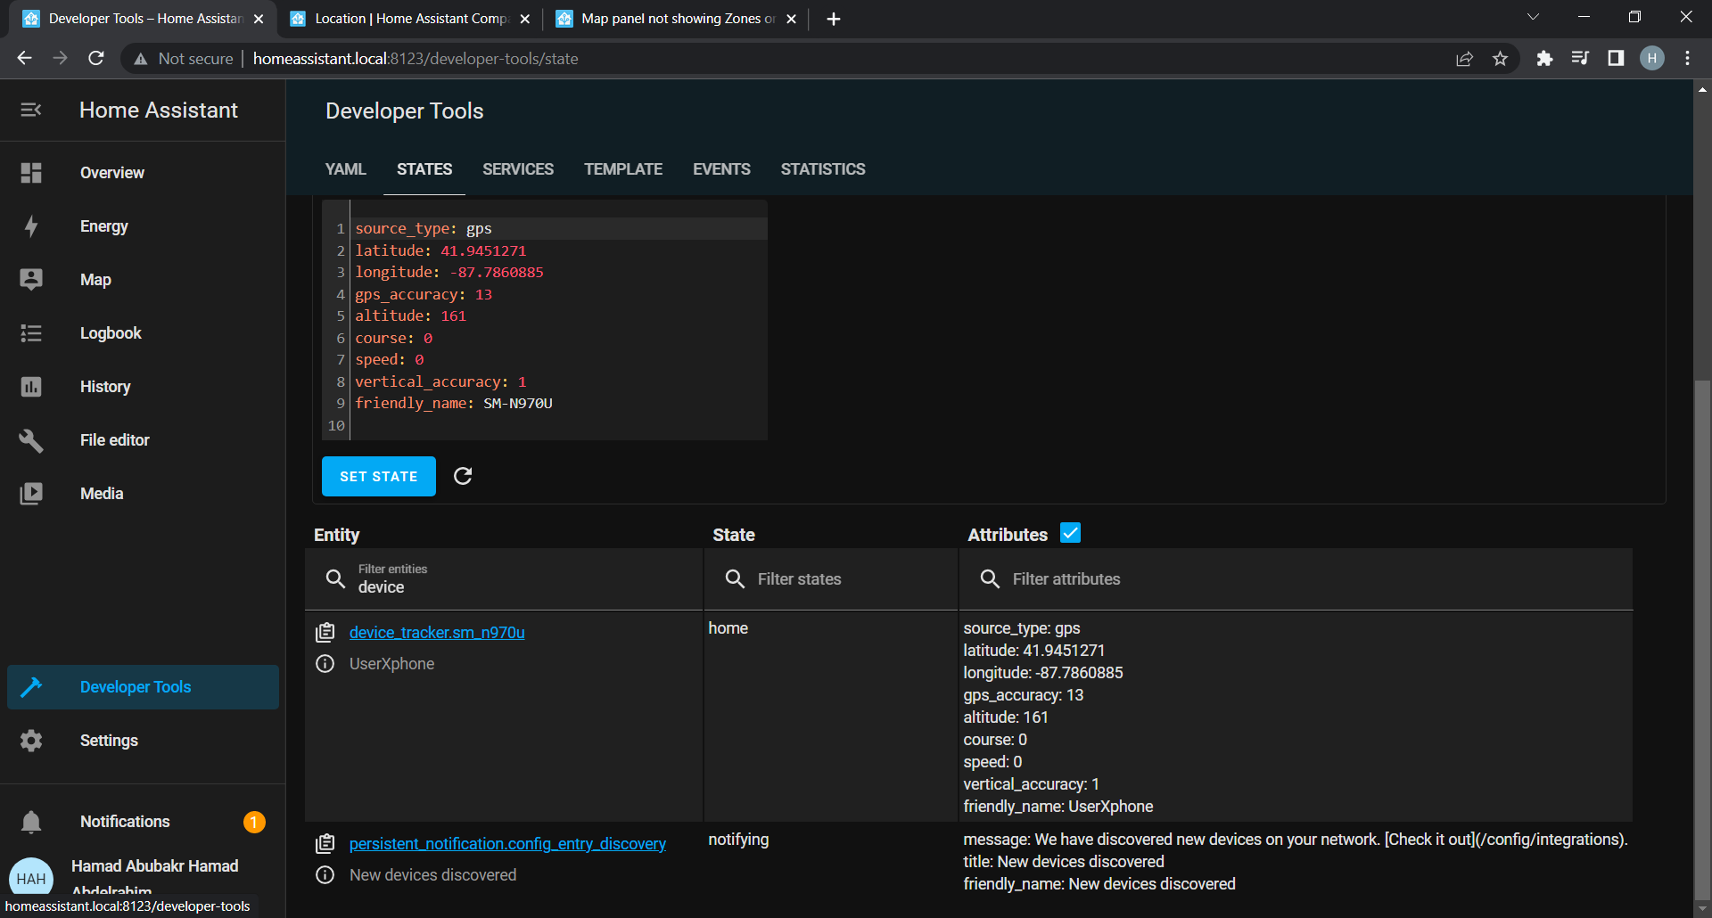
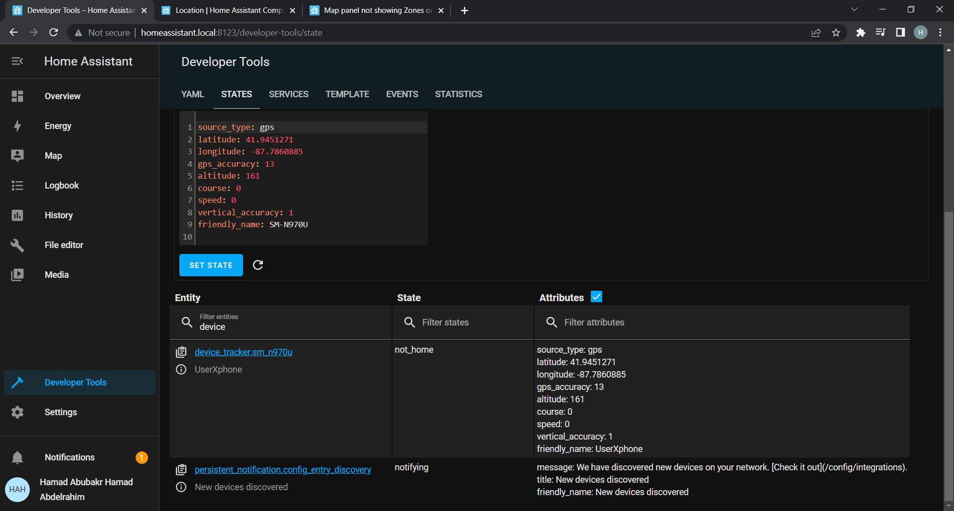
Presence System
GPS Based Detection
Uses the built in GPS functionality of the user’s phone.
The Home Assistant application will continuously get the user’s GPS location via their phone.
The location is sent to the Home Assistant OS for use.
It allows the creation of “zones” that the user can cause an action to occur, such as the system disarming, when they enter it.

Slide 18
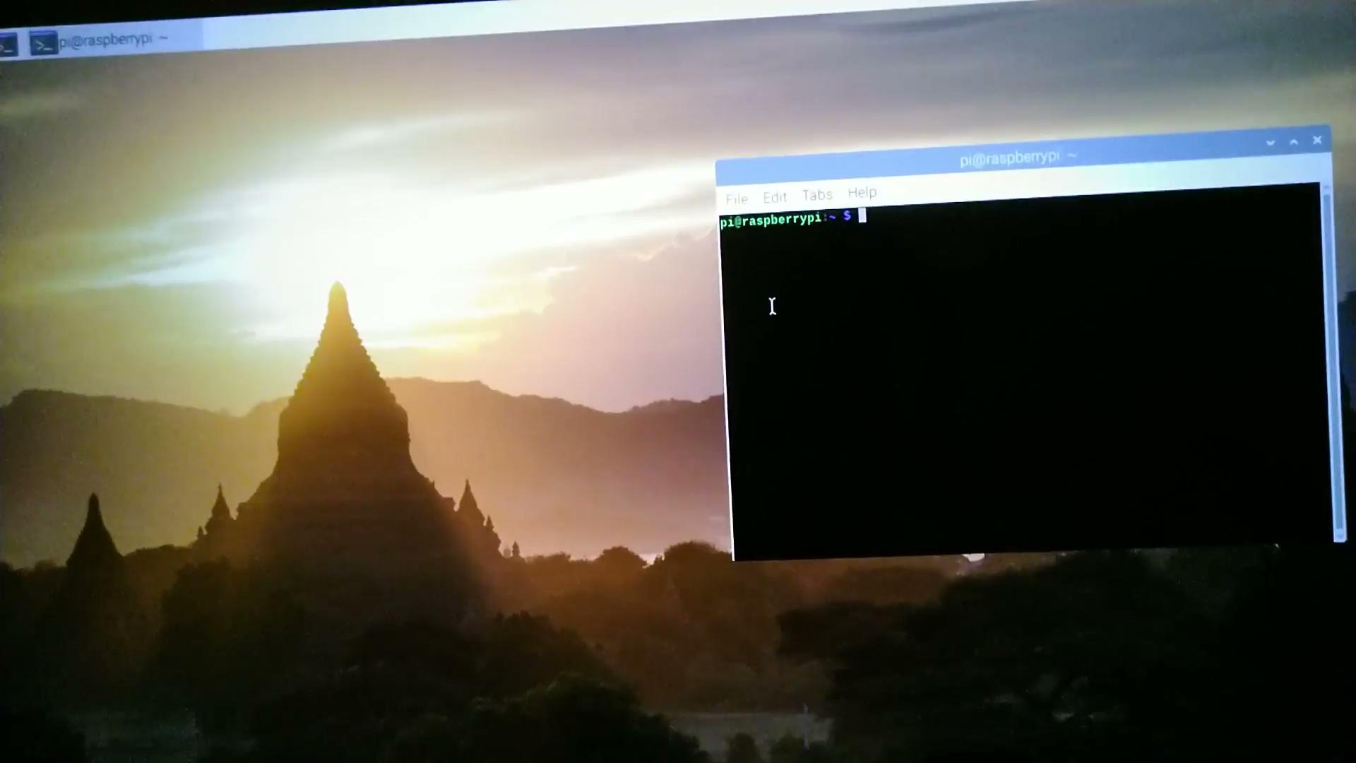
Facial Recognition System
Facial Recognition with OpenCV
Home Assistant Integration with DeepStack
An open source computer vision and machine learning software library.
Installed on RPi Debian, the software allows easy configuration and learning of new faces, and recognizes saved faces with great accuracy.
An AI server for computer vision applications like object and face detection and recognition.
The service can be integrated to HA and can be taught multiple faces for high-confidence recognition results

Slide 19
System Demonstration
Here is the Demonstration of our system with the Home Assistant and mobile notifications

Slide 20
Technical Challenges
Facial Recognition
Remote Connection
While working on improving the presence detection software, there were setbacks on the implementation of the DNS server with the router to accept remote access. We decided to change our approach and look over the existing cloud connection for the demonstration of the project.
With the core mechanism of this system being facial recognition, accuracy is vital. The camera set-up and programming of the facial recognition software took the majority of time due to which integration and automation with Home Assistant wasn’t completed to its fullest.
Power-Loss
We have attached rechargeable battery modules and programmed the hardware to either be on low-power mode or sleep-mode which activates the device only if the sensor detects anything.
Hardware Limitations
Due to memory issues on RPi 3B+ test environment, and the lack of a camera in the main HA environment, results were divided between the two, contributing to the setback in integration.

Slide 21
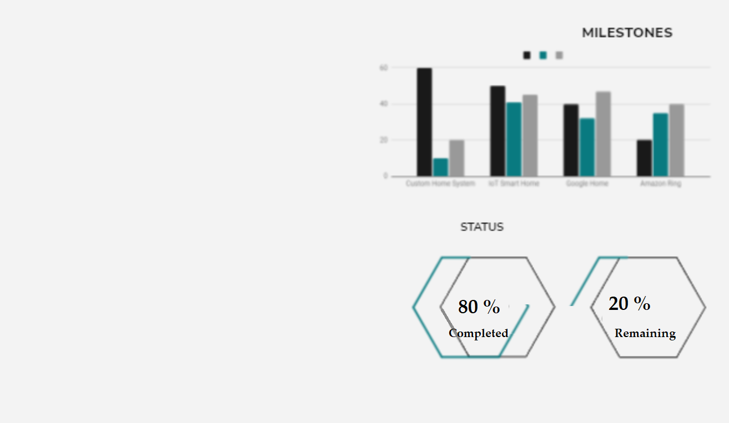
03
MILESTONES AND DISTRIBUTION

Slide 22
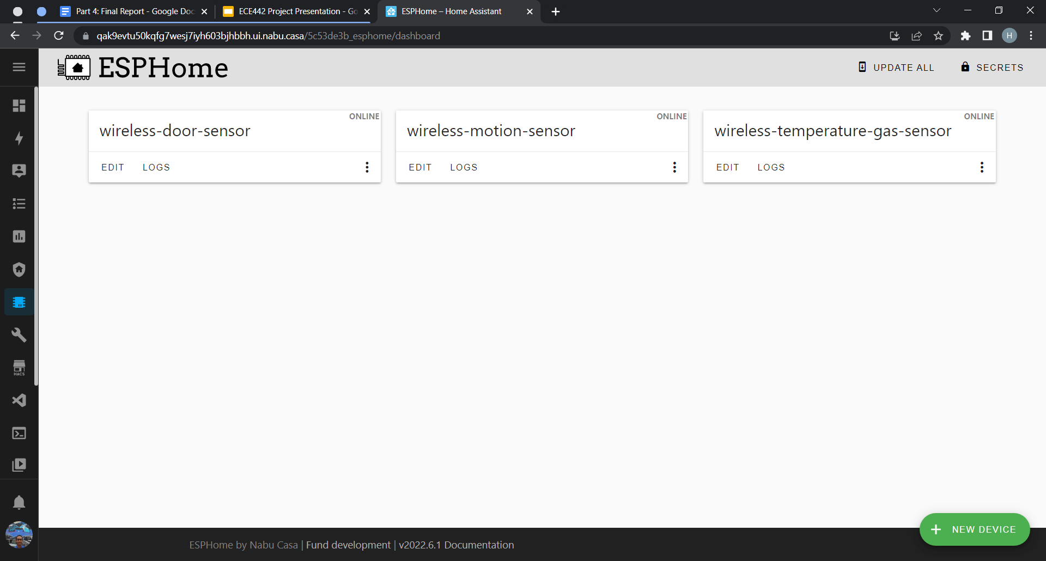
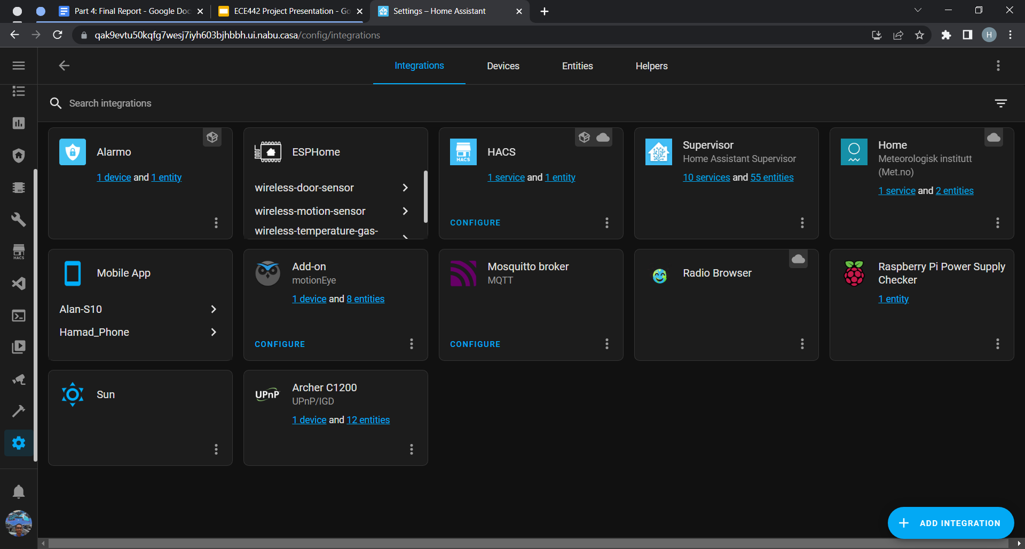
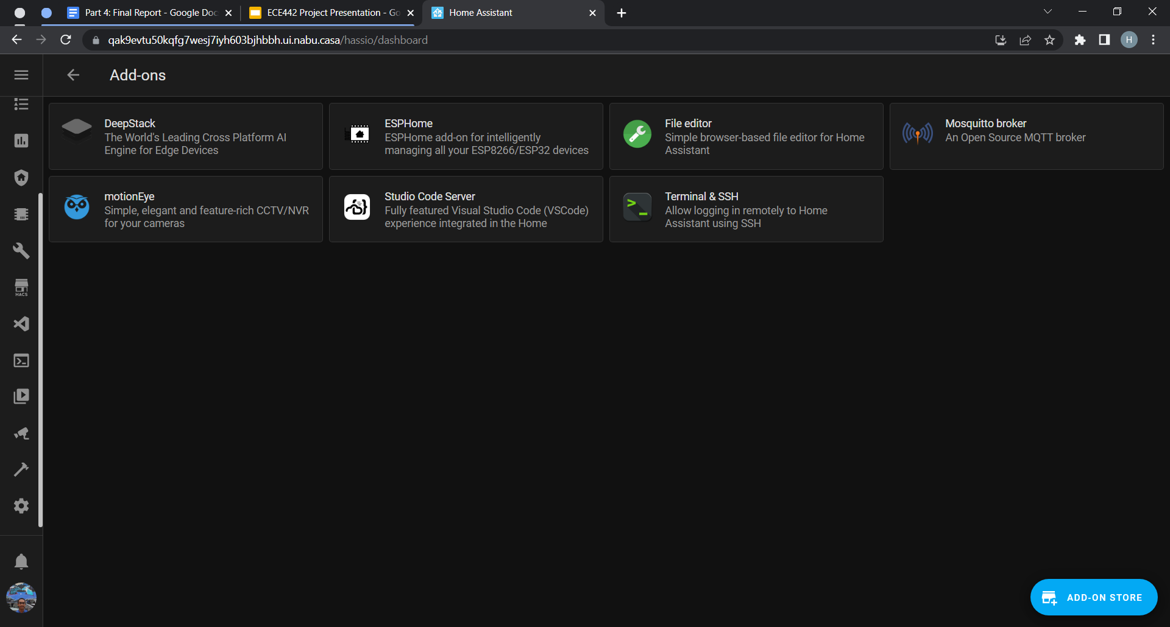
Progress and Milestones
ESP Connections
PLATFORM INTEGRATION
Facial Recognition
Presence Detection
Have the ESP8266 NodeMCU communicate with the Raspberry Pi via the LAN with OTA support
Successfully installed the Home Assistant OS on the Raspberry Pi and completed the platform set-up
Successfully established facial recognition with usb camera, but were unsuccessful with system integration and automation.
Successfully provided the ability for the system to detect the user’s presence via a GPS and Network based methods

Slide 23
Work Distribution
Hamad Abdelrahim
Alan Palayil
Nikhil Aditya Chaganti
Research on the working and implementation of various sensors and microcontrollers.
Look over different automations and presence detection protocols to implement in our system.
Design an existing system using ESP as the modes of communication between the sensor nodes and microcontroller ESP8266 NodeMCU.
Research on integration of the system and design for multi-node set-up in Home Assistant platform.
Research and look over the implementation of facial recognition softwares on Raspberry Pi.
Work on the integration of softwares within OpenCV like Deepstack and Double Take with Home Assistant platform.

Slide 24
Timeline
Buy necessary hardware (sensors) and assemble them to the arduino. Working on facilitating facial recognition.
Test the system. Reworking any issues that arise during testing. Finalizing the system for submission.
Discuss the ideas and brainstorm on the ones feasible
1st
3rd
5/6th
WEEK
WEEk
WEEK
2nd
4th
WEEK
WEEK
Discuss on the idea selected and work on the plan of action
Developing the companion application. Connecting the hardware to the local server (Raspberry Pi).

Slide 25
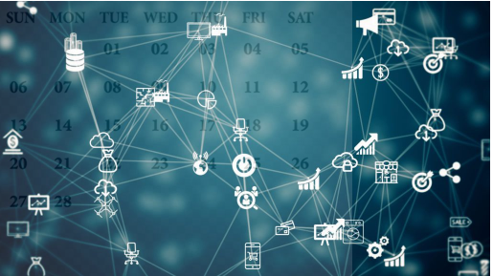
04
FUTURE WORKS

Slide 26
Future Works
OFFICIALS NOTIFICATION
Develop the program of the Smart Alarm system to notify authorities after a certain criterias such as: forced entry detection, motion detection while the system is in Away mode, and intruder alerts.
Easy Home Integration
WEEK
Have easy addition and integration of services like Google Home and Amazon Alexa
COMPLETE SMART HOME
Include the addition of smart home appliances including the controls of IoT devices and monitoring
1st
WEEK

Slide 27
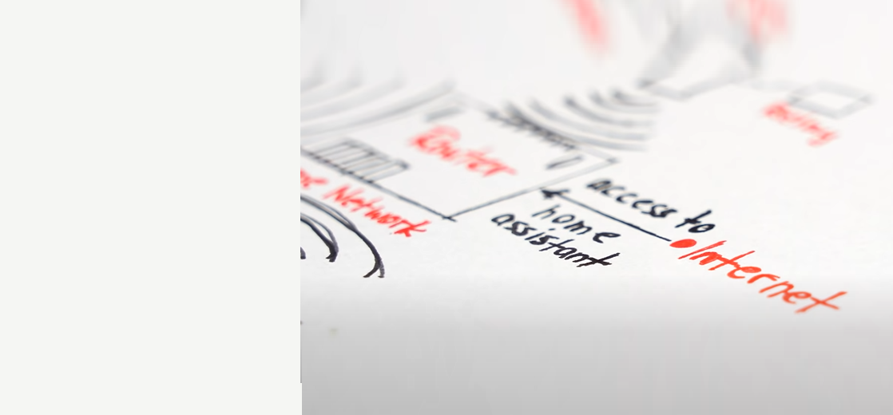
05
CONCLUSION AND REFERENCES

Slide 28
CONCLUSION
The project went on at a good pace with all the team members working and researching on their respective tasks.The Home security system can be incorporated with other IoT devices and systems to build a smart home ecosystem that learns from the user’s daily routine and helps in securing their home.
We considered scenarios in which parts of the system might fail or get bypassed by the intruder such as if the intruder manages to force the front door open, a contact sensor that is placed at the door will trigger and cause the system to send a notification to the user if they are home or call the authorities immediately if they are not.
The system comprises a couple of fault tolerances which include manual keypad, emergency hotspot, and back-up power. The system communicates completely via WiFi using the ESP protocol

Slide 29
REFERENCES
The following are the resources we have used until now for research and implementation.
OPENCV (FACIAL RECOGNITION)
Face Recognition Just Got Easier - Home Assistant Double Take Guide
OpenCV Set-up
GitHub - robmarkcole/HASS-Deepstack-face: Home Assistant custom component for using Deepstack face recognition
HOME ASSISTANT AND AUTOMATIONS
Getting Started - Home Assistant
Home Assistant Companion Docs
ESPHome
Example code for Home Assistant Tutorials for the Smart Home Junkie channel on Youtube
How I Secured My Home Using Home Assistant – Part One
https://community.home-assistant.io/t/i-can-t-send-notification-to-pushover/86639/5
PRESENCE DETECTION
Releases · ESPresense/ESPresense · GitHub
MQTT Explorer
How to Create a DIY alarm system with Home Assistant

Slide 30
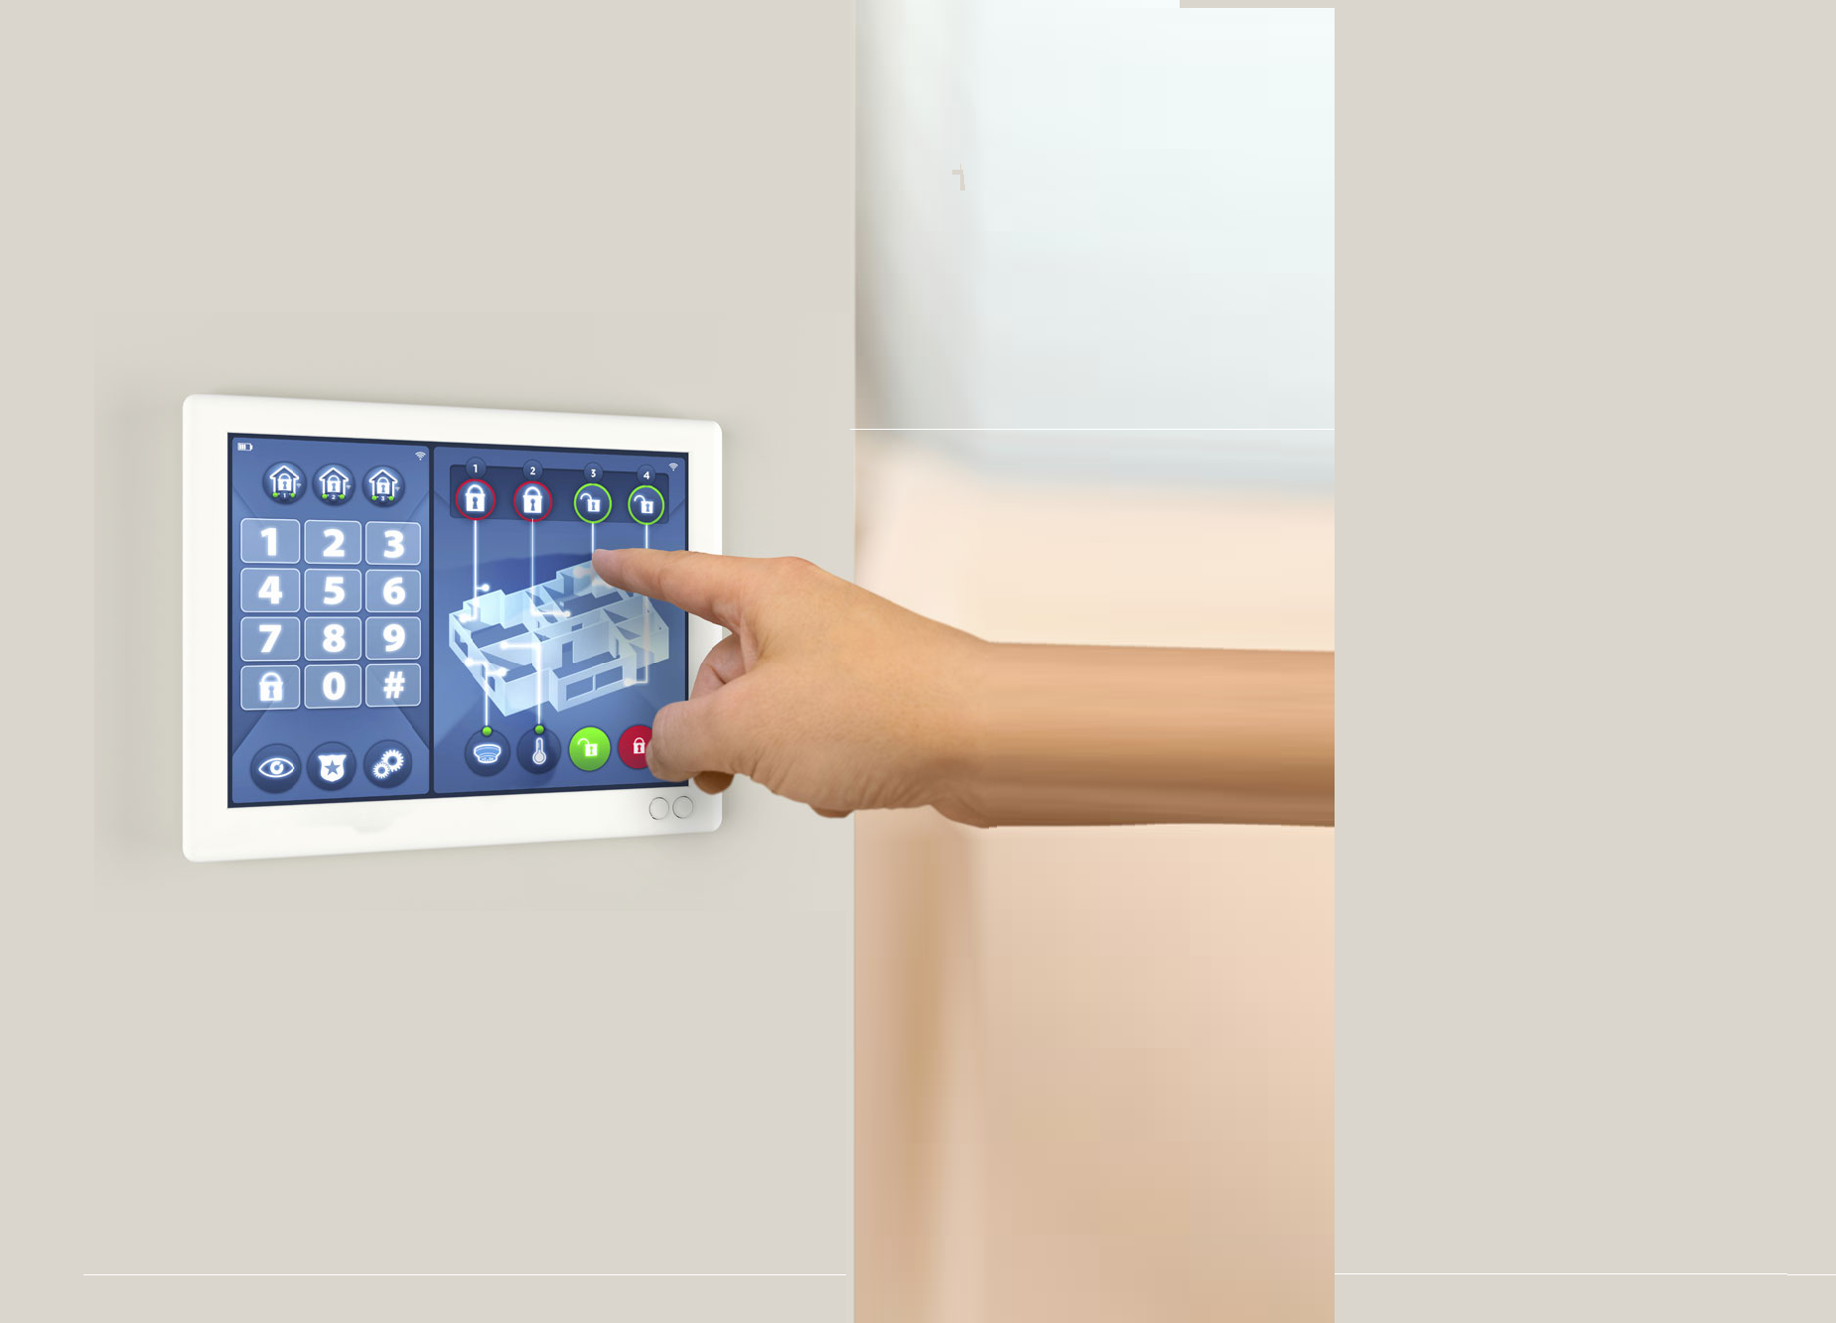
THANKS
Does anyone have any questions?

